Slide 1




STUDIO SHODWE
Home
Service
About Us
Contact
FASHION PRODUCT RECOMMENDATION USING MULTIMODAL LEARNING
Names: Marina Reda (221101235), Omar Adly (221101398)
Course: AIE417: Selected Topics in Artificial Intelligence 1
Instructor: Dr. Mohamed Ghetas
01

Slide 2
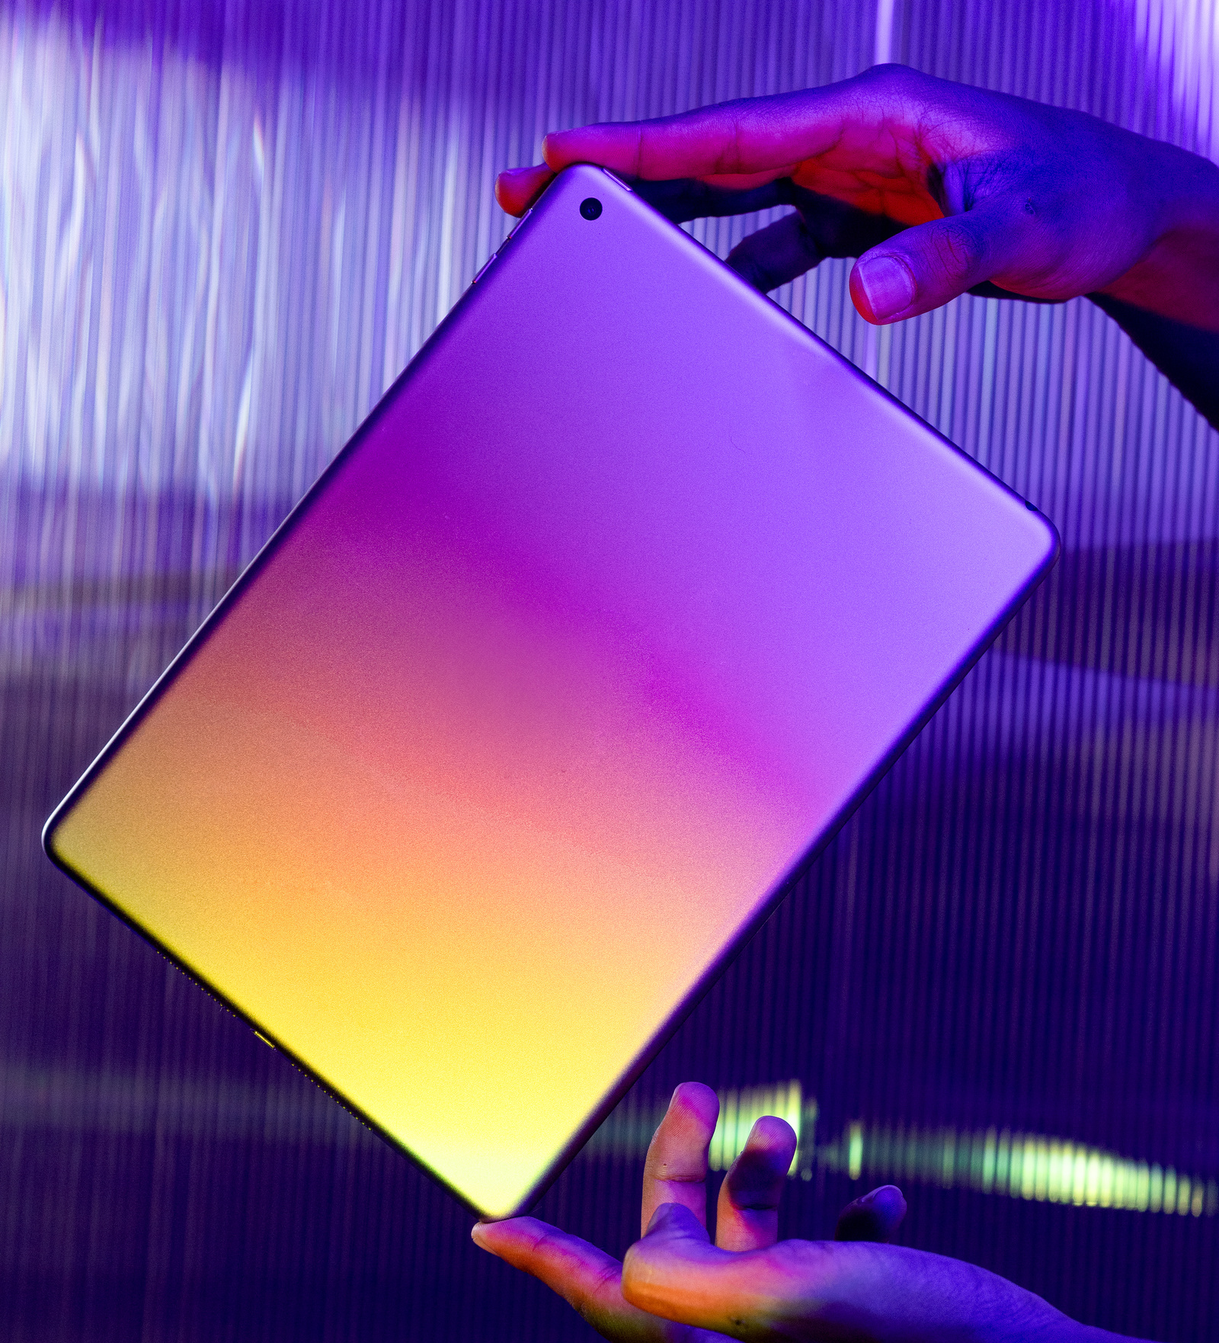

STUDIO SHODWE
Home
Service
About Us
Contact
Introduction
Problem Addressed: Explain the challenge of navigating vast product catalogs in online retail and the need for accurate product categorization and recommendations.
Objective: To leverage multimodal learning to classify fashion products by integrating image and text data for a better user experience.
Significance: Highlight how the approach improves shopping experiences and boosts customer satisfaction.
02

Slide 3
STUDIO SHODWE
Home
Service
About Us
Contact
Dataset
Dataset Description:
Total samples in dataset: 44441
Images: High-quality (1080 x 1440 px).
Text: Titles and descriptions of products.
Labels: Product categories.
Preprocessing Steps:
Images resized to 224x224 px.
Text tokenized and padded (max length: 100).
Labels encoded via one-hot encoding.
03

Slide 4
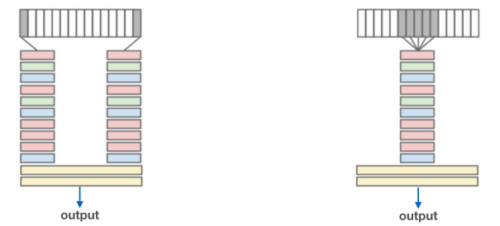
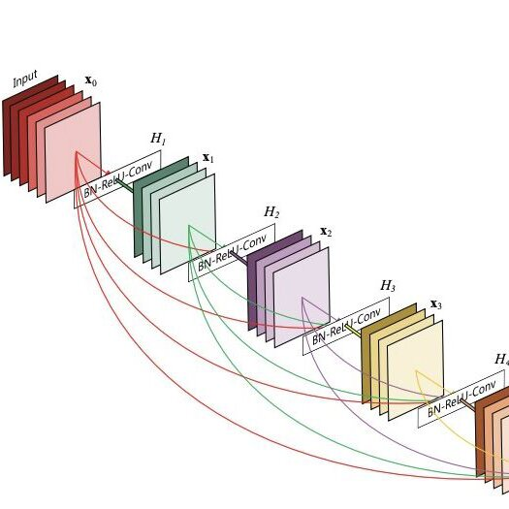
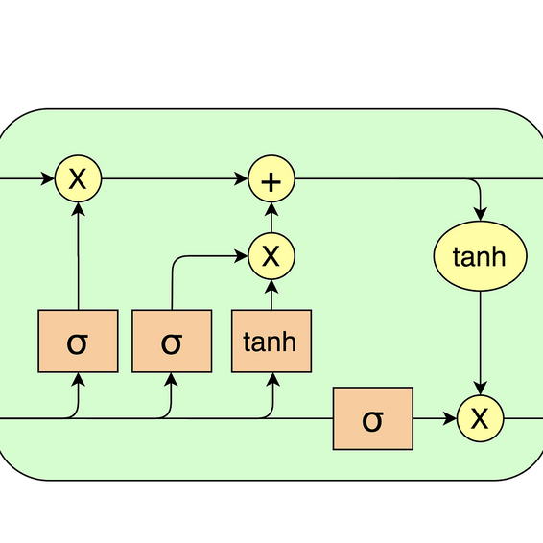
STUDIO SHODWE
Home
Service
About Us
Contact
Model Design and Implementation
Multimodal Learning Techniques:
Image: Features extracted using EfficientNetB0.
Text: Processed with an LSTM-based model.
Fusion: Early fusion by concatenating image and text features.
Model Architecture:
Image Input: EfficientNetB0 → Global Average Pooling.
Text Input: Embedding layer → LSTM.
Output: Fully connected layer with softmax for classification.
Implementation Details:
Framework: TensorFlow/Keras.
Optimizer: Adam (learning rate: 0.001).
Loss Function: Categorical Crossentropy.
04

Slide 5
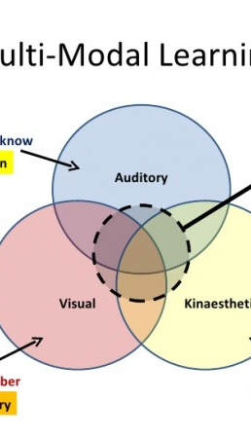
STUDIO SHODWE
Home
Service
About Us
Contact
Multimodal Learning Comparison
Paper | Model Architecture | Image Representation | Text Representation | Fusion Technique | Dataset | Accuracy
This Project | EfficientNetB0 + LSTM | EfficientNetB0 | LSTM | Early Fusion (Concatenation) | Curated Fashion Product Images Dataset | 91%
"Multi-modal Fashion Retrieval with Cross-modal Attention" | CNN + Transformer | CNN | Transformer | Cross-modal attention | UT-Zappos dataset | 89.5%
"Learning Deep Representations of Fine-grained Visual Descriptions" | CNN + LSTM | CNN | LSTM | Attention-based fusion | DeepFashion dataset | 88.3%
Demonstrate that the model (91% accuracy) outperformed existing models.
05

Slide 6

STUDIO SHODWE
Home
Service
About Us
Contact
Challenges
Balancing image and text feature contributions during fusion.
Handling missing or inconsistent text descriptions.
Improvements
Data Augmentation: Enhance generalizability with augmented datasets (images and text).
Hybrid Fusion: Explore advanced fusion techniques for better performance.
Transfer Learning: Fine-tune pre-trained models for domain-specific feature extraction.
06

Slide 7

STUDIO SHODWE
Home
Service
About Us
Contact
Conclusion
Multimodal learning proved effective for fashion product categorization.
Future Directions:
Incorporate additional data like user reviews and brand attributes.
Explore audio or video data for richer insights.
Emphasize the groundwork laid for AI-based recommendation systems to enhance personalization in e-commerce.
07

Slide 8
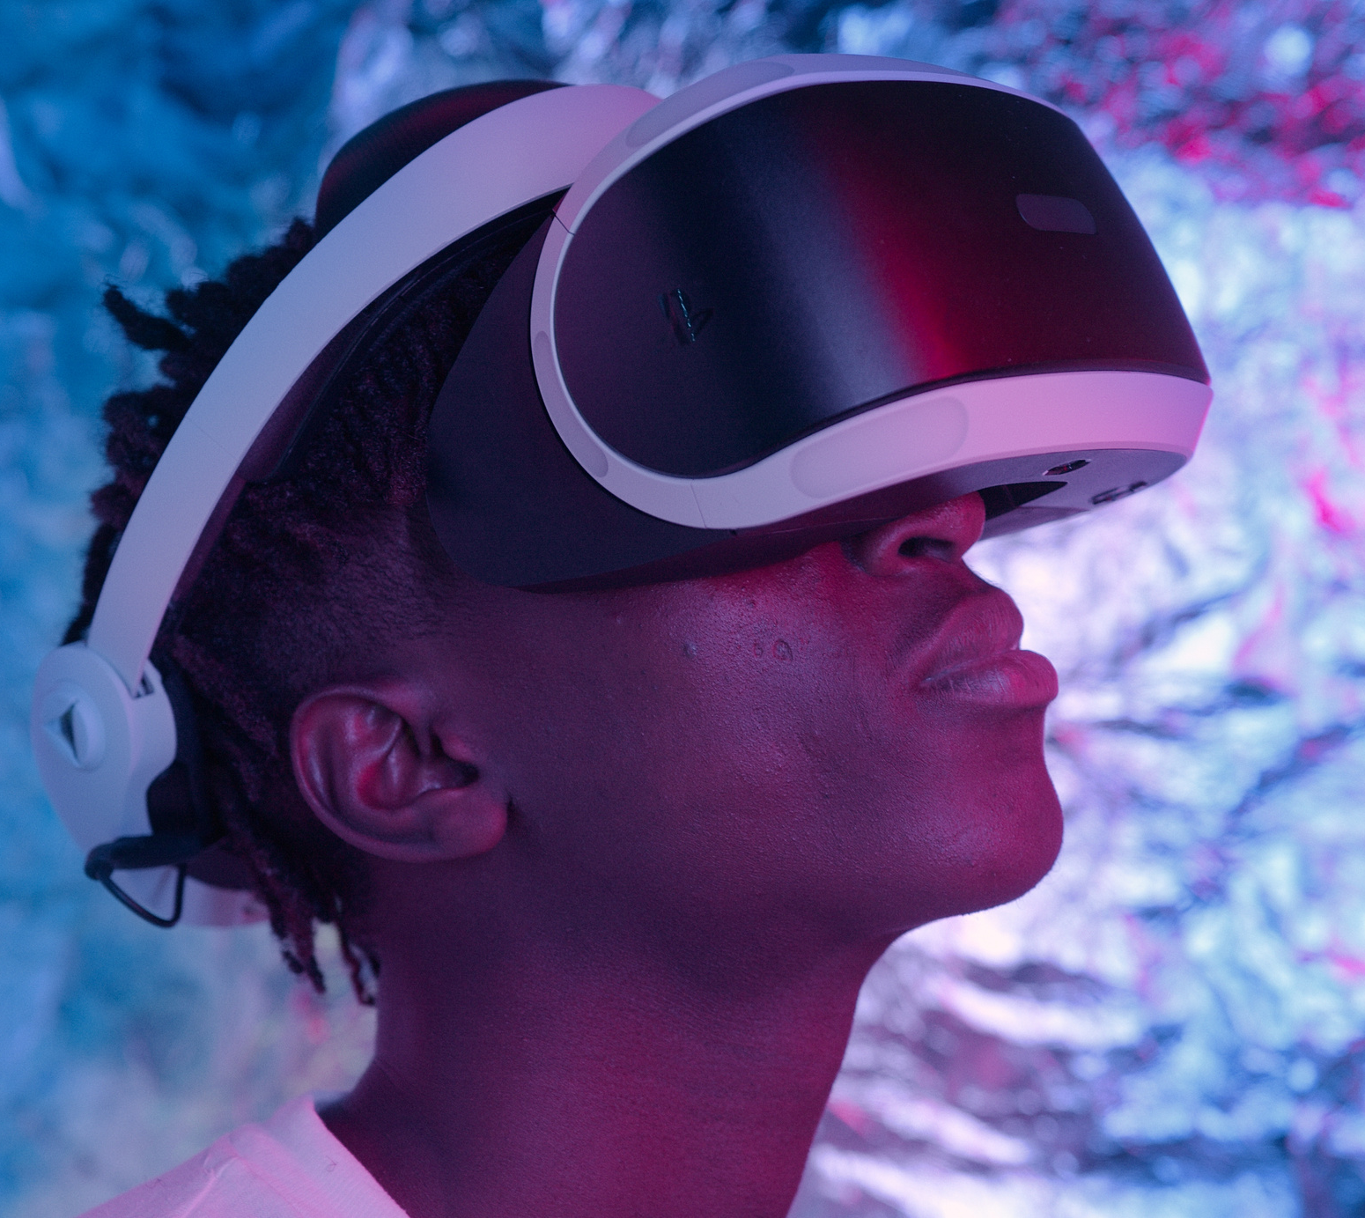
STUDIO SHODWE
Home
Service
About Us
Contact
THANK
YOU
Any questions ??
10

